Slide 1

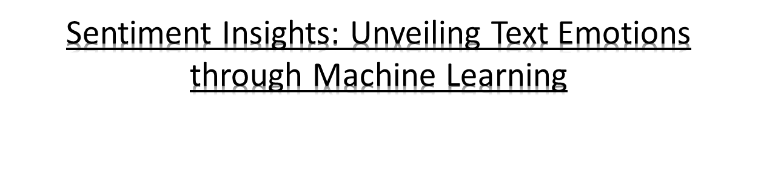
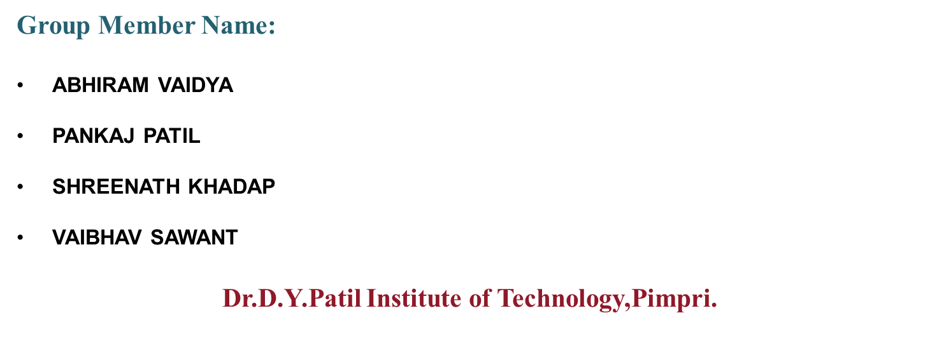
A Project Presentation for the Degree of Bachelor in Computer Engineering
A.Y 2023-2024

Slide 2
Table of Contents
Project Goal
Costing
Budget
Risk Analysis

Slide 3
Project Goal
The primary goal of this project is to create an accurate and resilient machine learning model that excels in classifying text-based content into different emotional categories.
This project aims to tackle the intricate task of emotion detection in natural language processing (NLP) and sentiment analysis. Emotion detection is inherently complex, and when applied to textual data, it becomes even more challenging due to the diverse and nuanced ways individuals express their emotions through written communication.
Therefore, the overarching objective is to develop a model that can effectively unveil and categorize the emotions conveyed within text, offering valuable insights for various applications such as customer sentiment analysis, social media monitoring, and content personalization.

Slide 4
Costing
The cost of a project like the one described, which involves developing a machine learning model for text-based emotion detection in NLP, can vary significantly based on several factors. Here are some cost considerations:Personnel: The biggest portion of the cost is often personnel. You'll need data scientists, machine learning engineers, NLP experts, and possibly domain experts depending on the specific application. Salaries and benefits for these professionals can be a substantial cost.
Data Collection and Annotation: Acquiring and annotating a large dataset of text with emotional labels can be expensive. You may need to hire human annotators or use third-party data sources, both of which come with costs.Computing

Slide 5
Resources: Training machine learning models, especially deep learning models, requires substantial computing power. You'll need to consider the cost of cloud computing resources or dedicated hardware.Software and Tools: Licensing fees for software and tools used in the project, as well as any custom development, should be factored in.Infrastructure:
This includes servers, storage, and networking equipment if you're setting up an on-premises infrastructure.Training and Skill Development: If your team doesn't already possess the necessary skills, you may need to budget for training or hiring additional expertise.

Slide 6
Budget
Creating a budget for your project involves estimating the costs associated with each aspect of the project and allocating resources accordingly. Below is a simplified budget outline for a machine learning project focused on text-based emotion detection in natural language processing (NLP). Please note that these are rough estimates and actual costs can vary widely based on the specifics of your project.
Personnel Costs:Data Scientists: $X per yearMachine Learning Engineers: $X per yearNLP Experts: $X per year
Data Annotators (if needed): $X per hourDomain Experts (if needed): $X per yearData Costs:Data Collection and Acquisition: $X
Data Annotation (if not done in-house): $XData Storage: $X per month (if using cloud storage)Computing Resources:Cloud Computing (e.g., AWS, Azure, GCP): $X per monthGPUs/TPUs (if needed): $X per
hourSoftware and Tools:Machine Learning Libraries (e.g., TensorFlow, PyTorch): $XNLP Libraries (e.g., NLTK, spaCy): $XCustom Development: $X

Slide 7
Risk Analysis
Risk analysis is an essential step in project planning and management. It involves identifying potential risks that could affect the successful completion of your text-based emotion detection machine learning project and assessing their potential impact. Below, I'll outline some common risks associated with such projects and how to manage them:
Data Quality and Quantity:Risk: Insufficient or poor-quality training data can lead to model inaccuracies.Mitigation: Carefully curate and clean your training data. Use data augmentation techniques if needed. Ensure you have a backup plan for acquiring more data if necessary.
Overfitting:Risk: The model might perform well on the training data but poorly on new, unseen data.Mitigation: Implement regularization techniques, cross-validation, and monitoring systems to detect overfitting. Use a holdout dataset for evaluation.

Slide 8
Resource Constraints:Risk: Running out of computing resources or budget limitations.Mitigation: Monitor resource usage, optimize code and model architectures for efficiency, and plan for scaling up resources as needed.Model
Complexity:Risk: Developing a model that is too complex and difficult to interpret.Mitigation: Balance model complexity with interpretability. Use simpler models when possible and employ model interpretability techniques.

Slide 9
THANK YOU

